Slide 1
Chiba campaign 2019
Yamaguchi Kodai
11月27日更新
DN=331

Slide 2
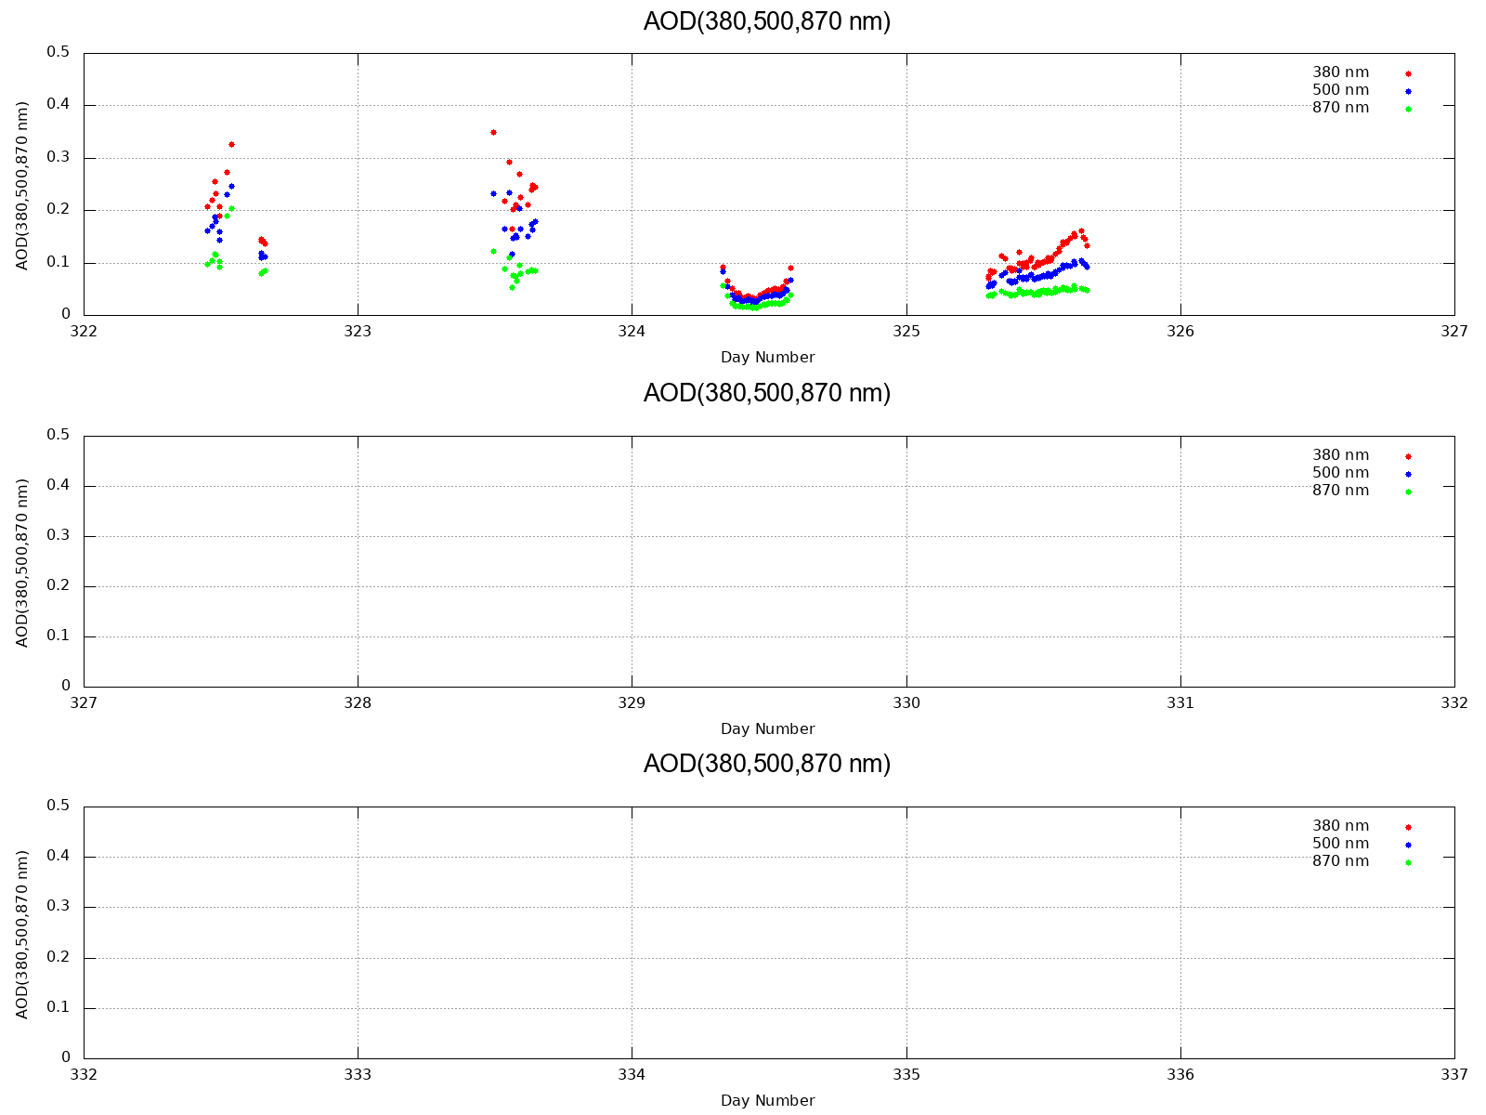
AOD (380,500,870 nm)

Slide 3
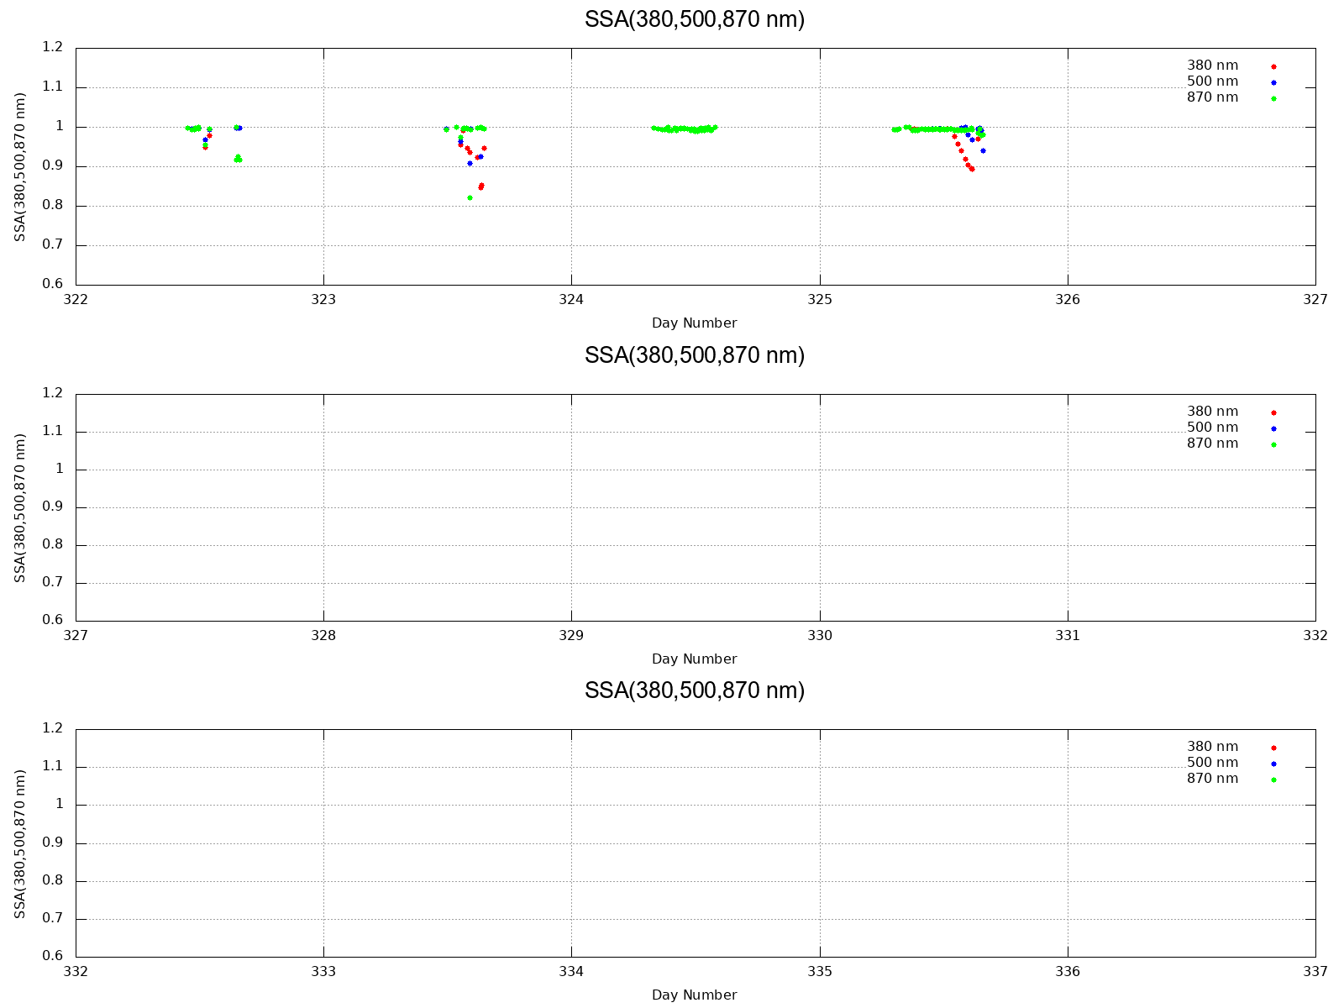
SSA (380,500,870 nm)

Slide 4
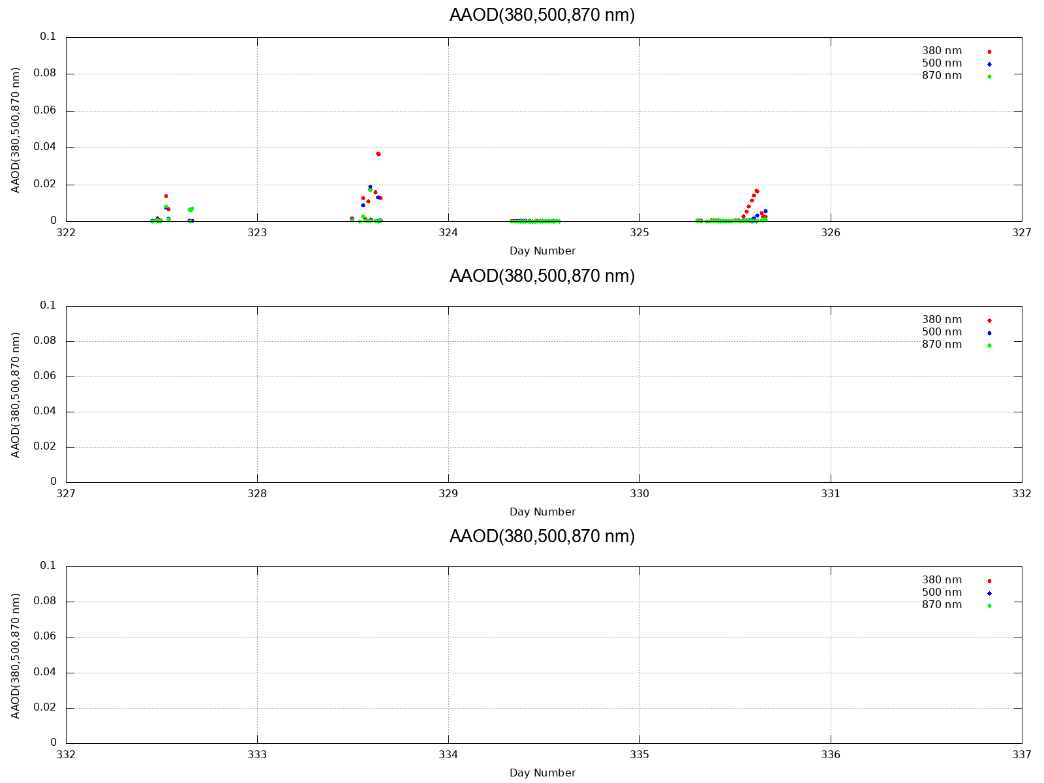
AAOD (380,500,870 nm)

Slide 5
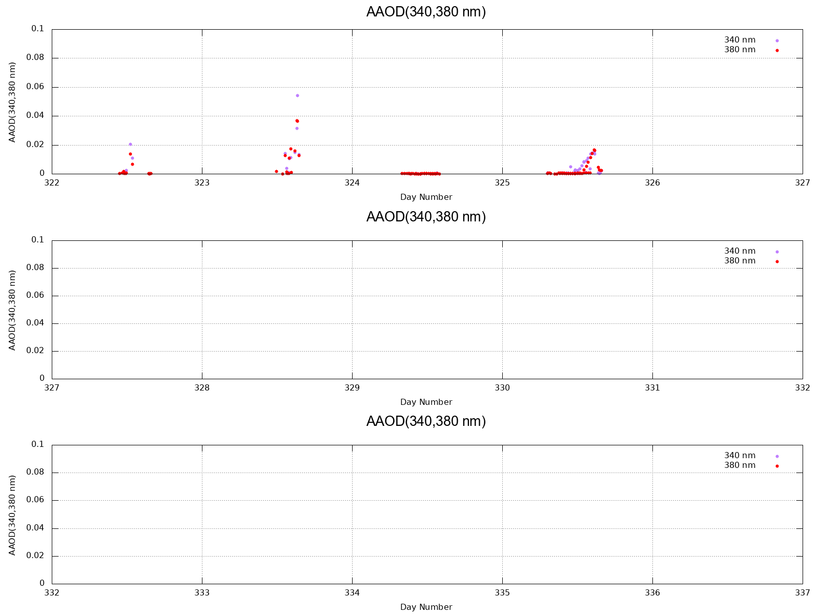
AAOD (340,380 nm)

Slide 6
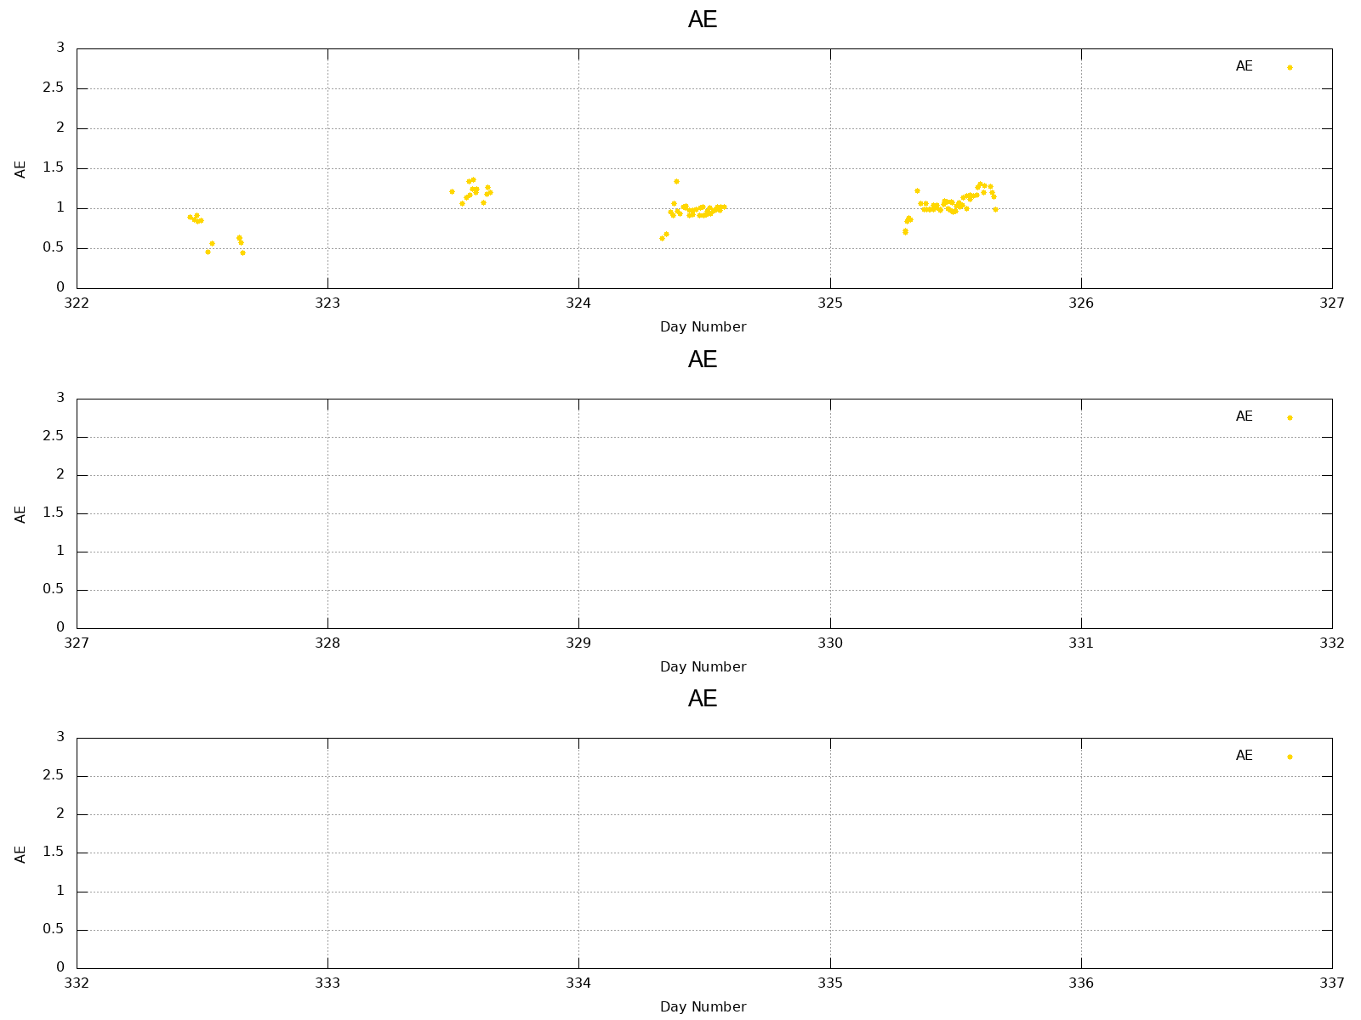
AE

Slide 7
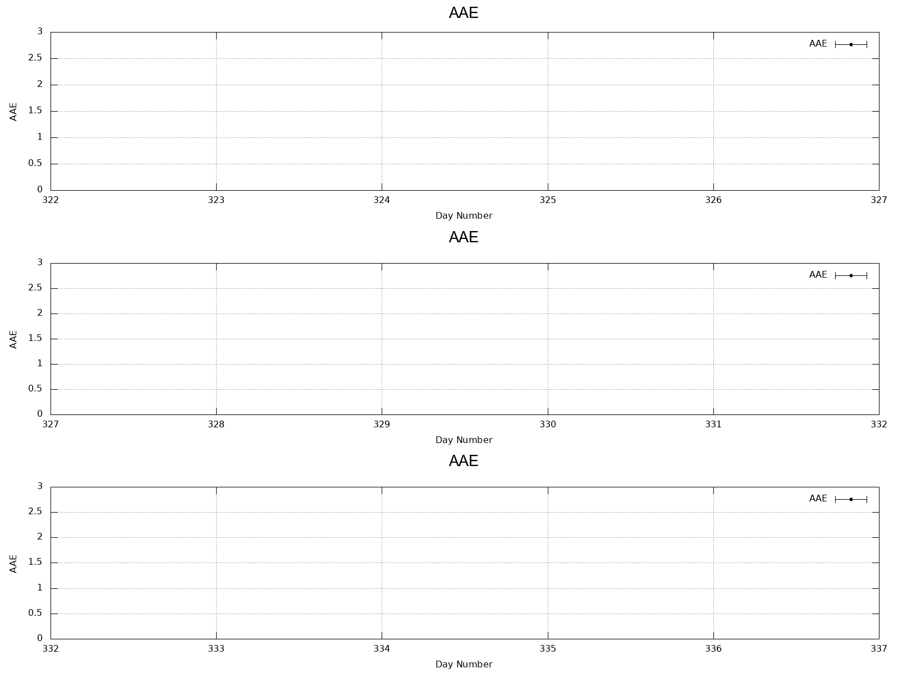
AAE (340~870 nm)

Slide 8
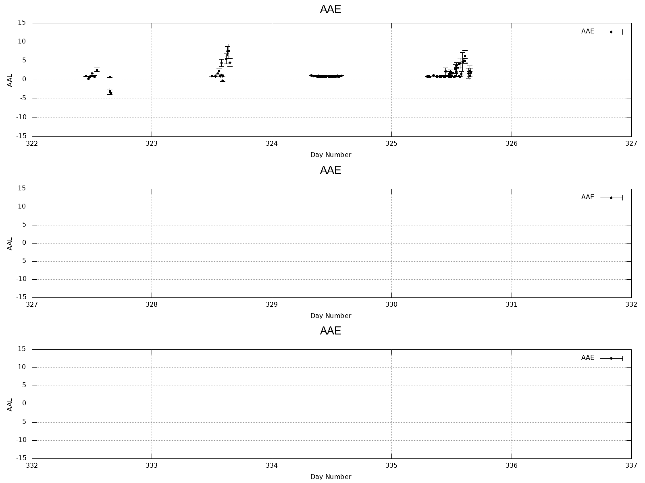
AAE (340~870 nm)雲データ除外の条件のみ

Slide 9
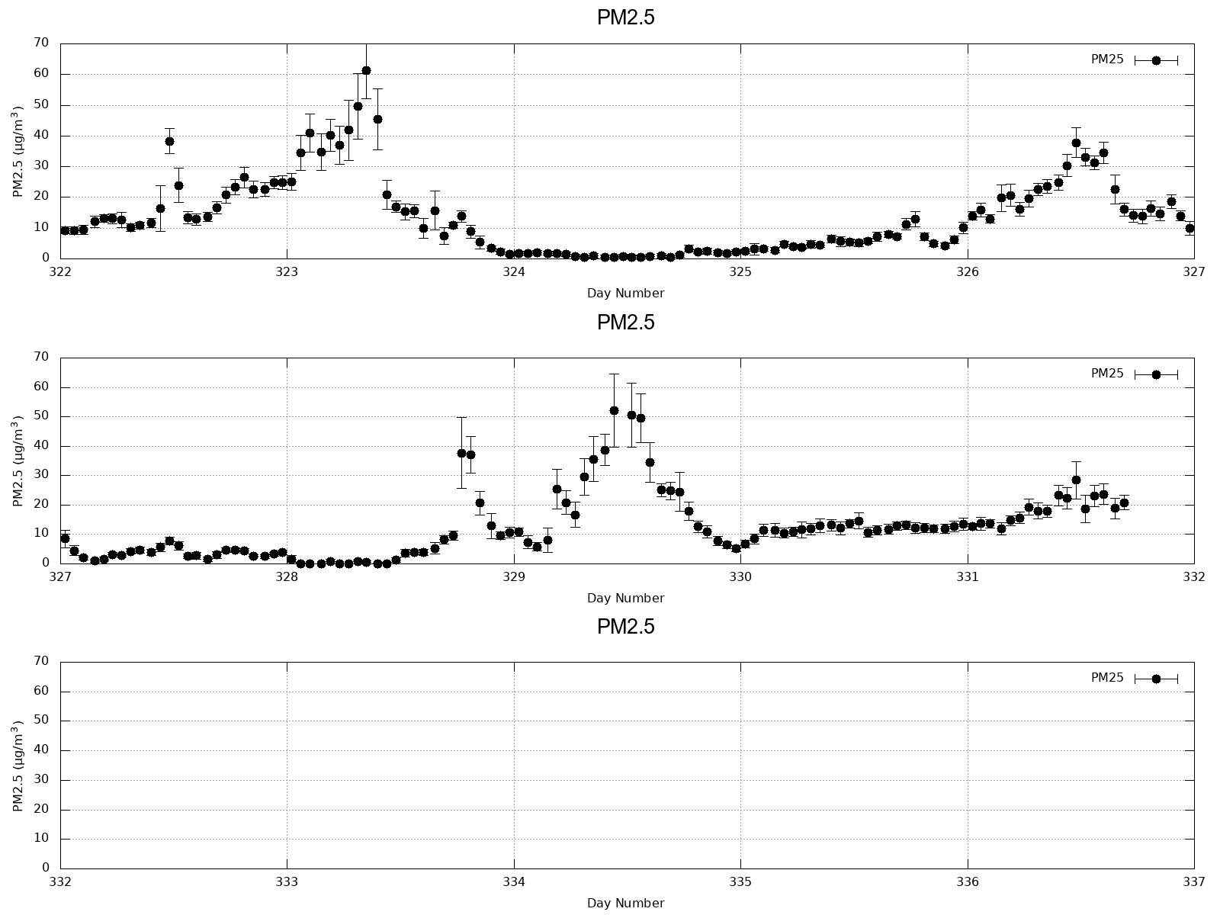
PM2.5 (1h)

Slide 10
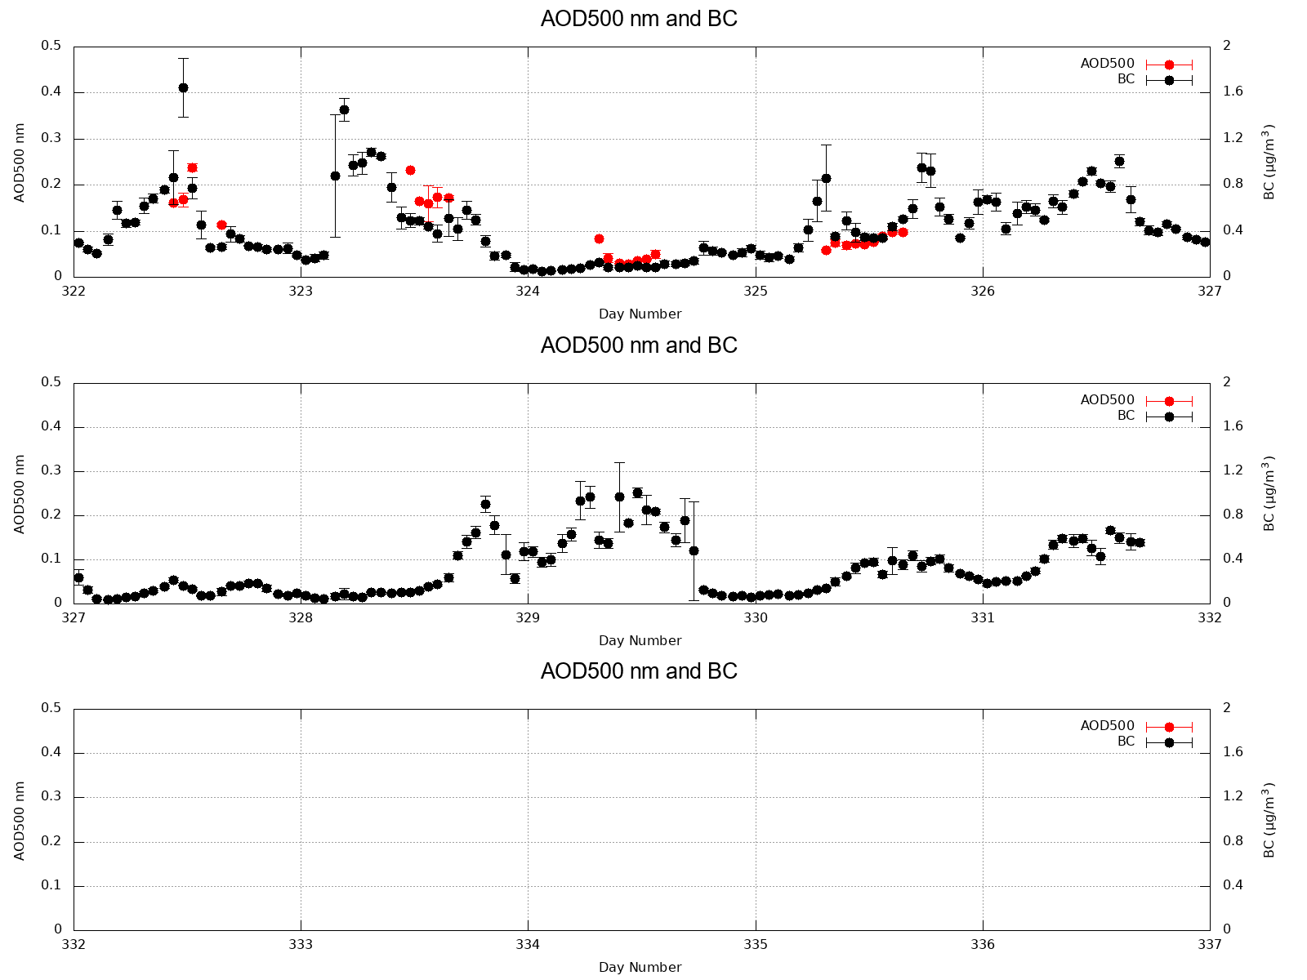
AOD(500 nm) and BC (1h)

Slide 11
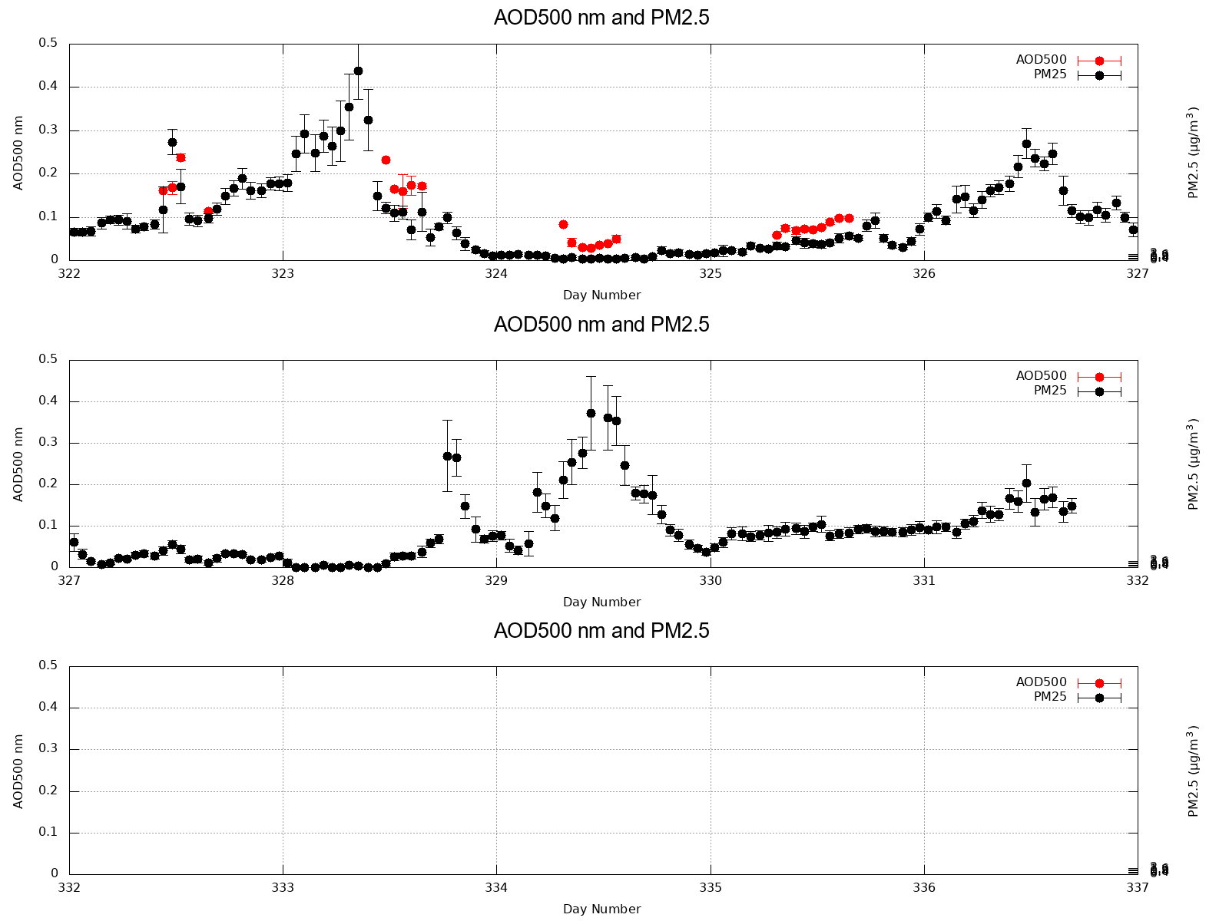
AOD(500 nm) and PM2.5 (1h)

Slide 12
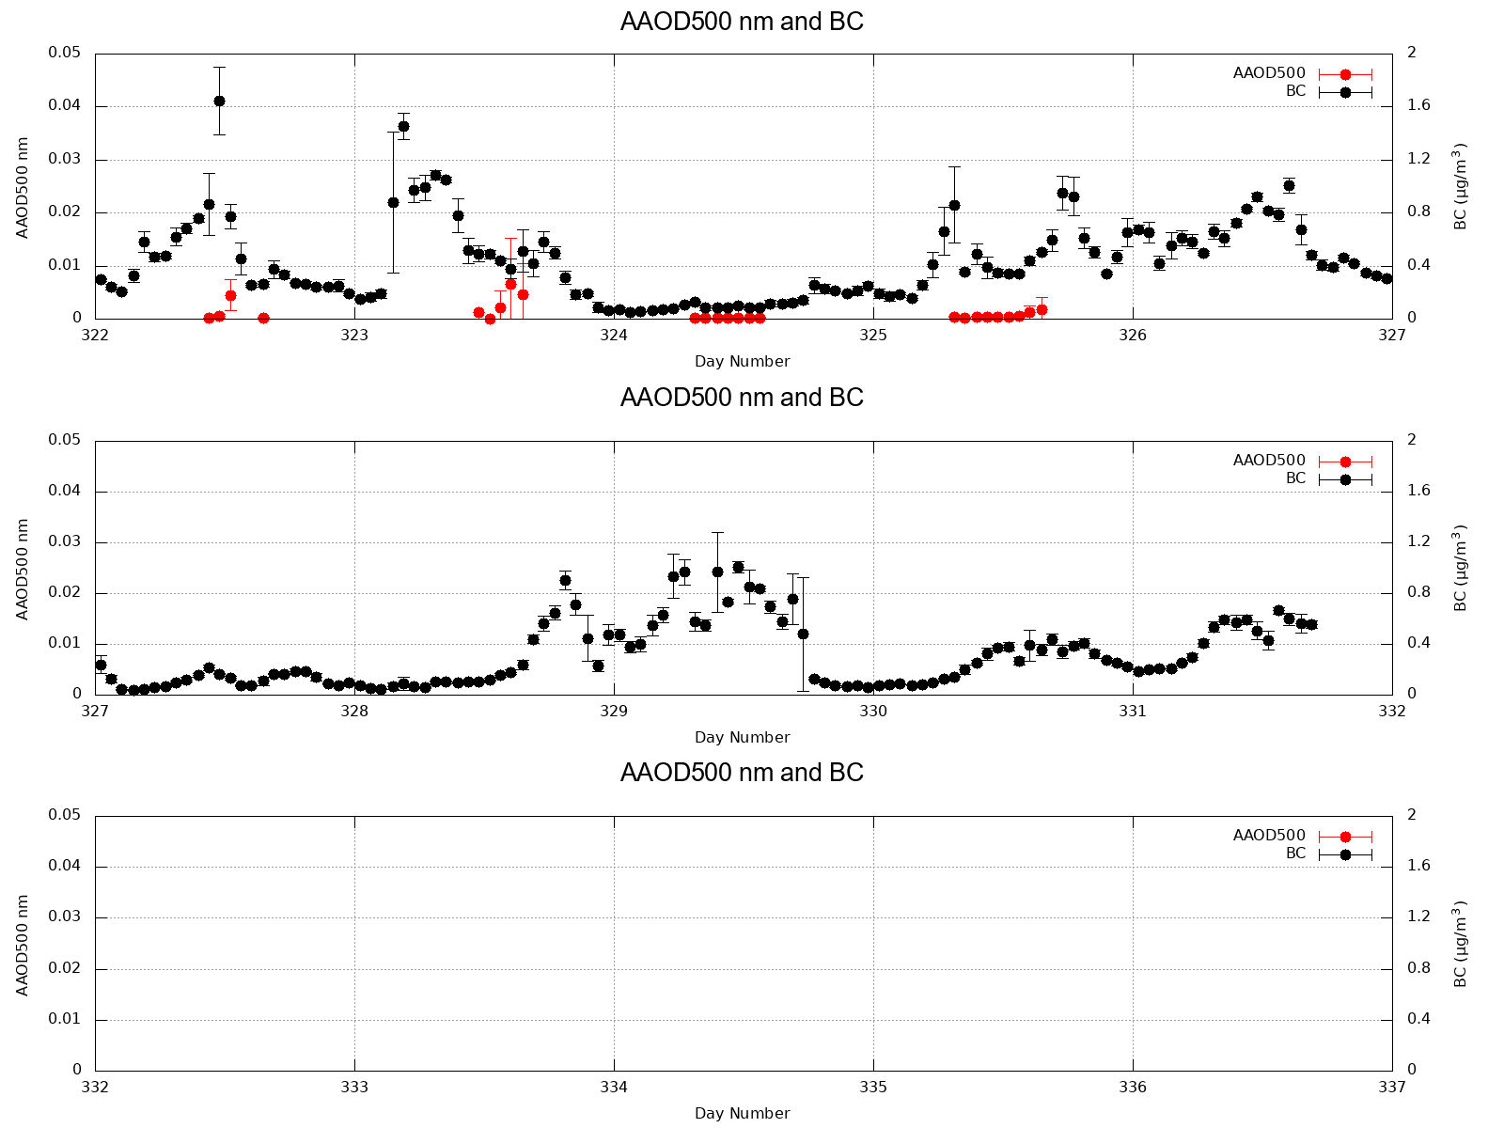
AAOD(500 nm) and BC (1h)

Slide 13
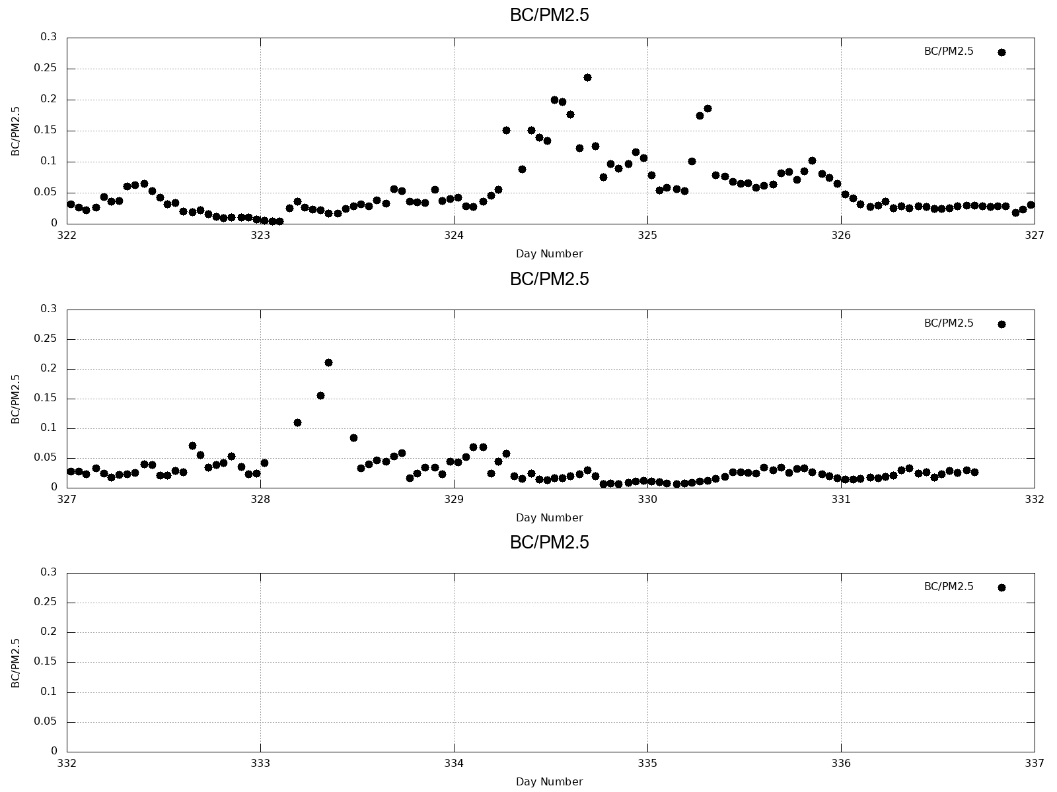
BC/PM2.5 (1h)

Slide 14
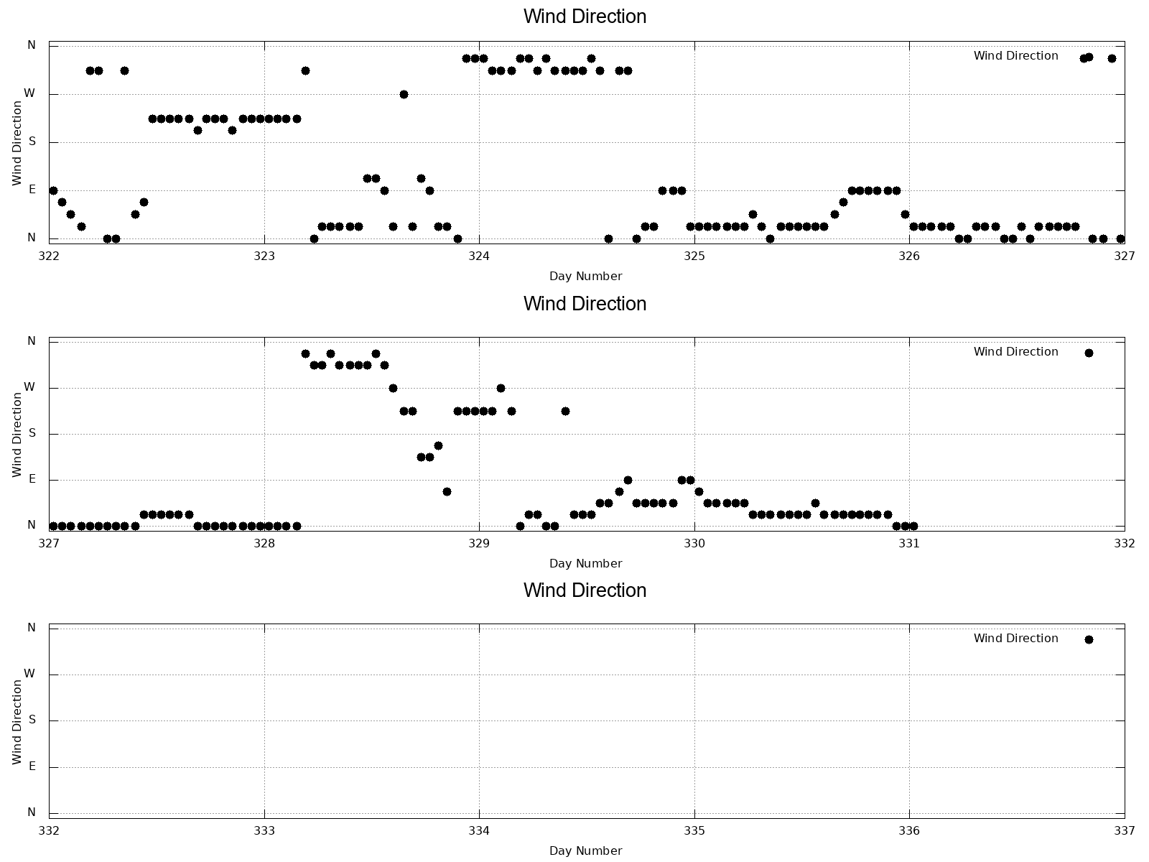
Wind Direction (1h)

Slide 15
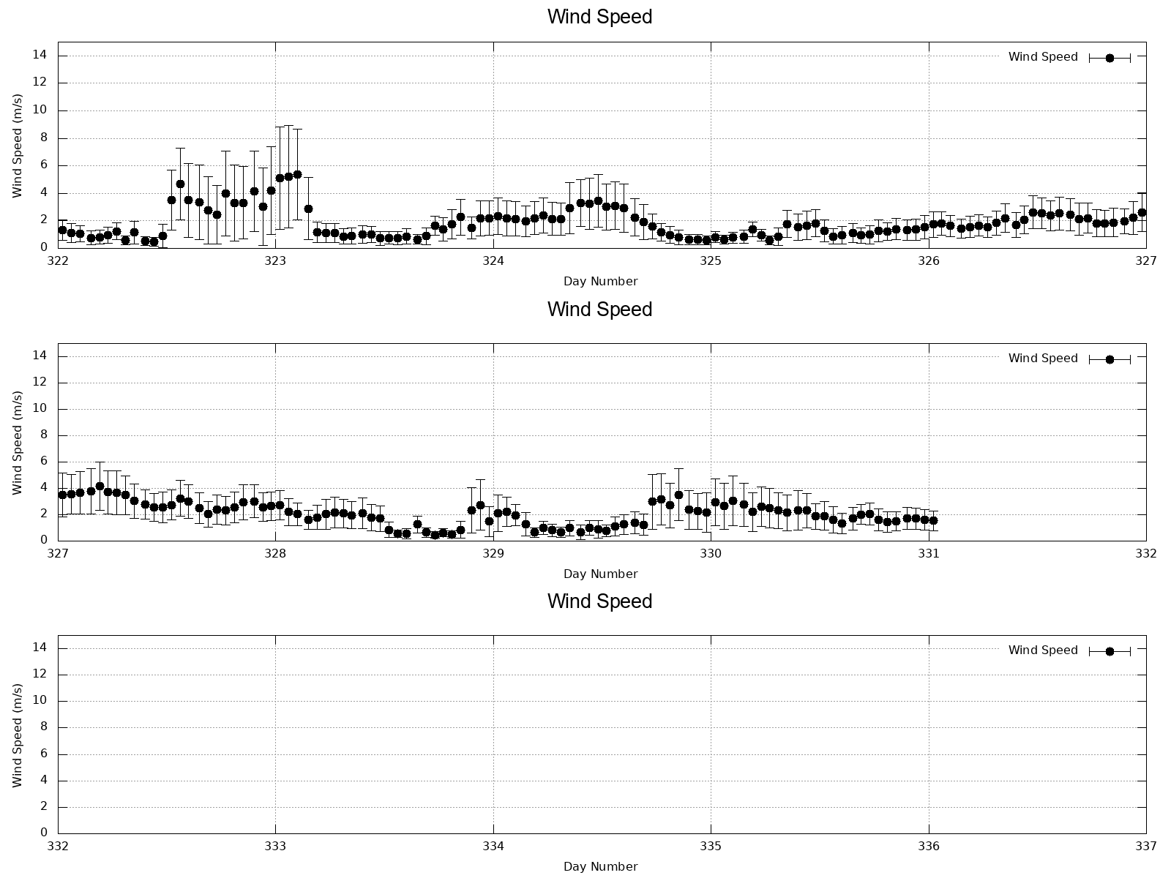
Wind Speed (1h)

